Slide 1
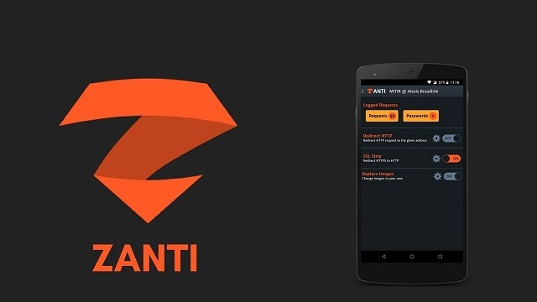
zANTI
BaselAlzyoud (ac0342) D.Nader Salameh
Mohammad Ayoush (ac0154) Smart Phone Security Jehad Mishal (ac0051)
Loay Alqatanani (ac0114)
Students Name:
Course info:

Slide 2

zANTI
zANTI is very infamous when it comes to hacking apps for Android.
This is because various people confuse it to be such an app.
It was primarily developed for penetration testing purposes and is a toolkit.
Originally developed by a company called Zimperium Mobile Security since it has not been kept updated we have seen various unofficial changes to the source code.

Slide 3
zANTI Features:
Hacking WiFi:This is a popular topic asked and searched a lot by users online. This simple app can let you guess someone’s password using the built-in tools that it provides you.
Change Device address: This allows you to change the physical MAC address of any devices, you could use this to bypass any Mac-filtration in place on routers or switches.
Password audit: This allows you to check the strength of passwords on the networks, tools such as Fern Wifi cracker can help for this task on Ubuntu and Windows.

Slide 4
zANTI Features:
Malicious WiFi Hotspot: You know that all of us are looking for free internet when needed. However, not everything free is good and the same goes for wireless access points. These can be maliciously created using zANTI so that you can track/capture the traffic of any device connected to your device.
Capture any HTTP traffic: You will be able to see any website they have visited or what they are doing in their browser.
Search for vulnerabilities: You can look for famous bugs in Linux servers including the popular Linux Shellshock. This allowed you access to the (root) user of bash so that it can be compromised further.
SSL Poodle MiTM Attack: This was a vulnerability discovered in SSL 3.0. This vulnerability allows attackers to see encrypted messages. An example would be of seeing WhatsApp messages similar to how the WhatsApp crash code works.

Slide 5
Downloading zANTI
First of all, you will need to have a clean and safe version of zANTI to download so that you can later go on and install it on your device. This can be either Android, Linux, or Windows.
https://s3.amazonaws.com/zANTI/zAnti3.19.apk
You can download the app through this link from the official site but first it will ask you to type an email address anything will work.
Once you launch the app, you will be prompted with installing apps from unknown sources, please accept that. Once it has been installed a root access prompt will appear mostly from SuperSU which you will need to grant.

Slide 6
zTether
zTether is a module that allows you to create your own malicious wireless hotspot on the go. Why would you do that? Well, this is so you can capture network traffic.
To turn it on please follow the steps below:

Slide 7
How to use zTether
Click on the “Tether Control” slider on the top-right and turn it to “On”.
Now you have started your own “free” wireless network. This will allow users to connect to your network.
To view their traffic click on “Logged Requests”. This will display all the active and real-time HTTP requests being served. This can include any sensitive passwords if they are on an insecure login page.

Slide 8
Mac Changer
People have been changing Mac Addresses on their devices for quite some time now.
However, this process is very technical, dangerous, and requires skill.
To use zANTI’s built-in Mac Changer feature is very easy and anyone can use it.
The uniqueness of this tool is that it generates random addresses which are valid.
You can do so by selecting “Set new Mac Address”.
You can also manually type in the Mac Address you prefer but I would not advise you to use this option.

Slide 9
zPacketEditor
This feature is only for professional security and ethical hackers.
You can use this for editing HTTP request packets on the network To use it:
First, you will have to turn the module on from the app.
Now you will start seeing live traffic on the wifi network you are connected to or the hotspot you created above using zTether.
These will mostly be URL addresses all starting with “HTTP”. To send one you will need to swipe-right and to edit it will be to swipe-left.

Slide 10
HTTP Redirect and Image Replacement
If you want to change the destination of a website a user is visiting you can do so.
This can be for purposes such as phishing.
You could redirect a user trying to visit the official Gmail page to a phishing page.
By default, this feature redirects to a number of Zimperium servers. You will have to manually specify the specific site where you want the traffic to go by entering in the “URL” field.
The “Replace Images” feature allows you to do the same but with images.
This allows you to change a particular image in a webpage that a user is trying to visit.
You can select one of your choices from your Gallery or from the web such as Google Images.

Slide 11
Capture all downloads
As you can intercept simple HTTP traffic, you can also intercept what other users are downloading.
These can be either important PDF files or Word Documents.
You can specifically tell zANTI that you would only like to capture PDF or Word files and it will only scan the network for any requests being made for a PDF or Word file. You can later choose to save it to your device storage locally or save it to an SD Card.

Slide 12
Routerpwn and HTML Insertion
Routerpwn.com is a site that holds a database of router vulnerabilities.
It contains exploits from various router companies including Netgear, TP-Link, Asus, and Linksys.
These work and integrate solely very easily with the feature of zANTI.
Once you exploit it you can use our list of default router logins to access the administrative dashboard.
If you want to insert HTML into an HTTP request that a user has done on your network you can do so easily.
For this to work, you will need to turn on the module and insert your code.
This can either be any malicious code or even an XSS code you are trying to inject on the site or even an SQL Injection.
Alternatively, you can download tools such as Havij to perform such tasks.

